Slide 1
Software Architecture Course overview

Slide 2
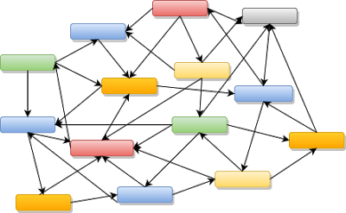
CS 590 Software Architecture
Architecture styles
Architecture patterns
Architecture principles and best practices
1 application
Service oriented
ESB
Microservices
DB

Slide 3
Relationship with other courses
Web
Application
Programming
Web
Application
Architecture
Software
Engineering
Database
Management
Systems
Browser
Application
Enterprise
Architecture
Advanced
Software
Development

Slide 4
Architecture styles
Client
Server
Minimal functioning core
Function1
Function2
Function3
Function4
data
data
Client-server
Plugin
Plugin
Plugin
data
Microkernel
Procedural
Client
Presentation
Service
Business logic
Integration
Layering
Pipe-and-Filter
Domain Driven Design
Object oriented
master
slave
slave
slave
Master-Slave
Component based

Slide 5
Architecture styles
Service oriented
ESB
Shared
data
Blackboard
Event Driven
Microservices
Stream
hub
DB
Hub and Spoke
Monolith
Stream based

Slide 6
Lesson 1 Software Architecture Introduction

Slide 7
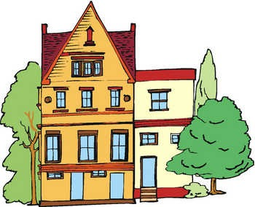

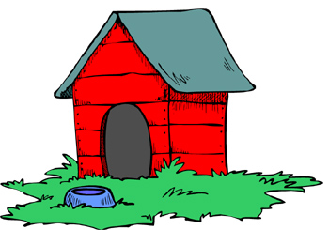
Why architecture?
More complexity asks for:
More abstraction and decomposition
More principles and guidelines
More communication
More proces
More powerful tooling
More complexity asks for more architecture

Slide 8
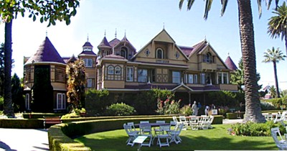
Why architecture?
Winchester “mistery” house
38 years of construction work– 147 builders 0 architects
160 rooms– 40 bedrooms, 6 litchens, 2 basements, 950 doors
No architecture description
65 doors that don’t go anywhere, 13 stairs that don’t go anywhere, 24 skylights where you cannot see the sky

Slide 9
What is software architecture?
The fundamental concepts or properties of a system in its environment embodied in its elements, relationships, and in the principles of its design and evolution
- ANSI/IEEE std 1471-2000

Slide 10
What is architecture?
• Modules, connections, dependencies and interfaces
• The big picture
• The things that are expensive to change
• The things that are difficult to change
• Design with the bigger picture in mind
• Interfaces rather than implementation
• Aesthetics (e.g. as an art form, clean code)
• A conceptual model
• Satisfying non-functional requirements/quality attributes
• Ability to communicate (abstractions, language, vocabulary)
• A degree of rigidity and solidity
• A blueprint
• Systems, subsystems, interactions and interfaces
• Governance
• The outcome of strategic decisions
• Structure (components and interactions)
• Technical direction
• Strategy and vision
• Building blocks
• Standards and guidelines
• The system as a whole
• Tools and methods
• A path from requirements to the end-product
• Guiding principles
• Technical leadership
• The relationship between the elements that make up the product
• Foundations
• An abstract view
• The decomposition of the problem into smaller implementable elements
• The skeleton/backbone of the product

Slide 11
What is architecture?
Shared understanding of the system
The decisions that are hard to change
The important stuff
Whatever that might be

Slide 12
Different kinds of architecture
Infrastructure
Security
Technical
Solution
Network
Data
Hardware
Enterprise
Application
System
Integration
IT
Database
Information
Process
Business
Software

Slide 13
Different kinds of architecture
Enterprise Architecture
Define enterprise wide aspects like people, processes, applications, infrastructure, etz.
Business Architecture
Define the processes, strategies and goals of the business.
Information Architecture
Define the information and services needed to support the business
Application Architecture
Define the structure and dynamics of software applications.
Software
Architecture
Infrastructure Architecture
Define the hardware and software infrastructure

Slide 14
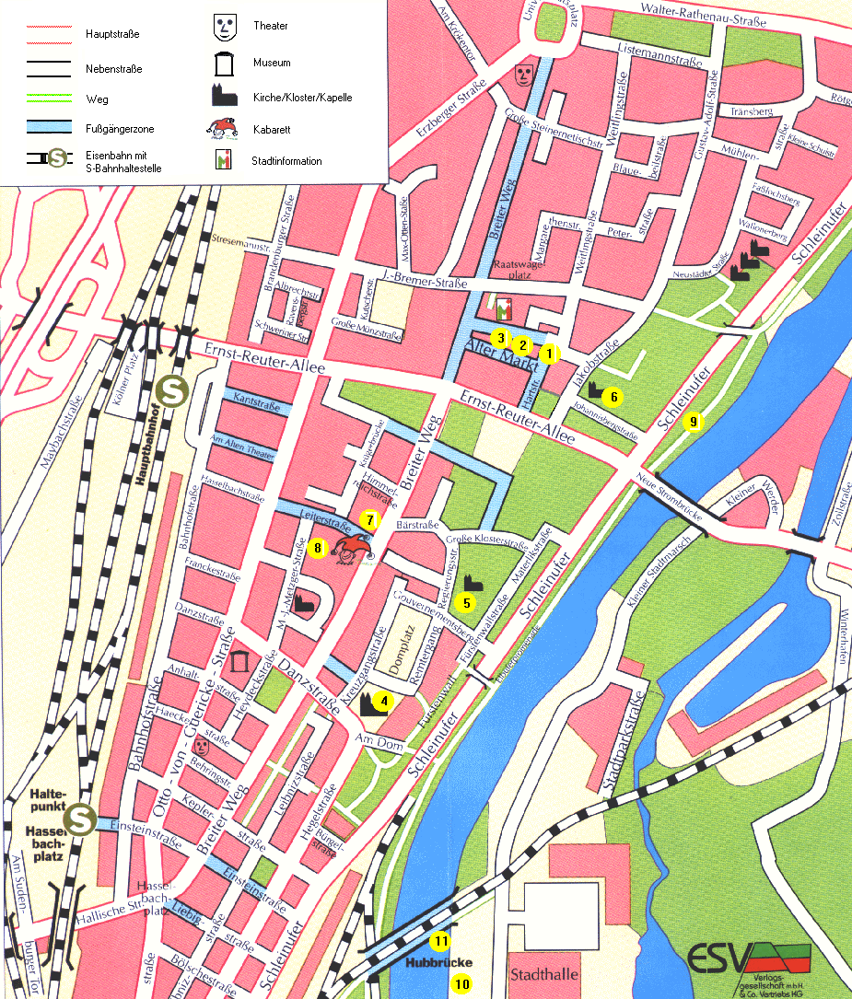
City planning
Business Architecture :
Goals of the city and the processes in a city
Information Architecture:
healthcare, education, water, electricity, transport, …
Application Architecture :
hospital, police, library, schools, …
Infrastructure Architecture :
roads, railroads, harbour, airport, …

Slide 15
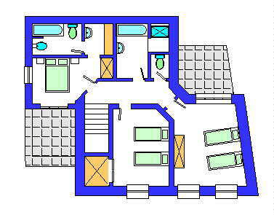
House planning
Information Architecture:
water, electricity, heating, …
Application Architecture :
Living room, bedrooms, kitchen, …
Infrastructure Architecture :
Electrical wires, water pipes, driveway,…

Slide 16
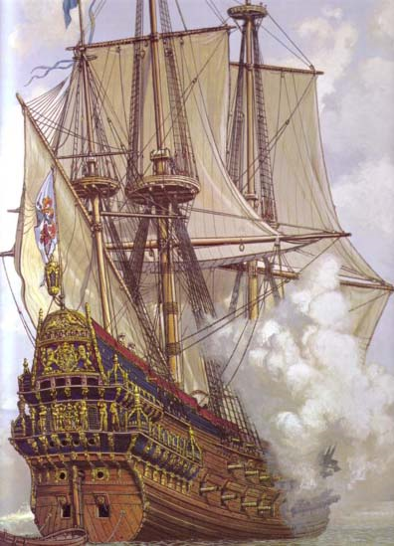
Warship Vasa
Customer
King of Sweden
Gustav II Adolf
Requirements:
70 m long
300 soldiers
64 guns
2 decks
Architect
Hendrik Hybertson

Slide 17
Software architecture is hard!
Complexity
No physical limitations
Huge state-space
Constant change of
Business
Technology
The architecture is never ideal
The work of an architect: Make non-optimal decisions in the dark.

Slide 18
Defining the architecture
Define components
Define component interfaces
Define platform and language(s)
Define architectuur styles
Define architectuur patterns
Define layers and packages
Define presentation architecture
Define persistency architecture
Define security architecture
Define transaction architecture
Define distribution architecture
Define integration architecture
Define the deployment architecture
Define the clustering architecture
Define the hardware
Define tools to use
Decide on solutions for
Logging
Error management
Error detection
Error reporting
Fault tolerance
Event management
File handling
Printing
Reporting
Resource management
Internationalization
Licence management
Debugging
…

Slide 19
Main point
Software architecture is based on architecture styles, principles and patterns
The human physiology has the same structure as the structure of the Veda and Vedic literature who are expressions of the structure of pure consciousness.

Slide 20
Agile architecture

Slide 21

Traditional architecture
The architect designs the system
Big upfront architecture
Large Software Architecture Document (SAD)
Ivory tower architect
The architecture is not understood and implemented by the developers
The architect does not understand the current technology
The architect is only available in the beginning of the project

Slide 22
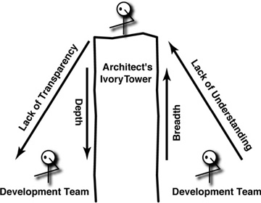
Ivory tower architect
It is very hard to truly know the best solutions for design problems if you are not working (coding) on the project
It takes many iterations of a solution before it finally works - so you can’t suggest a solution and then leave

Slide 23
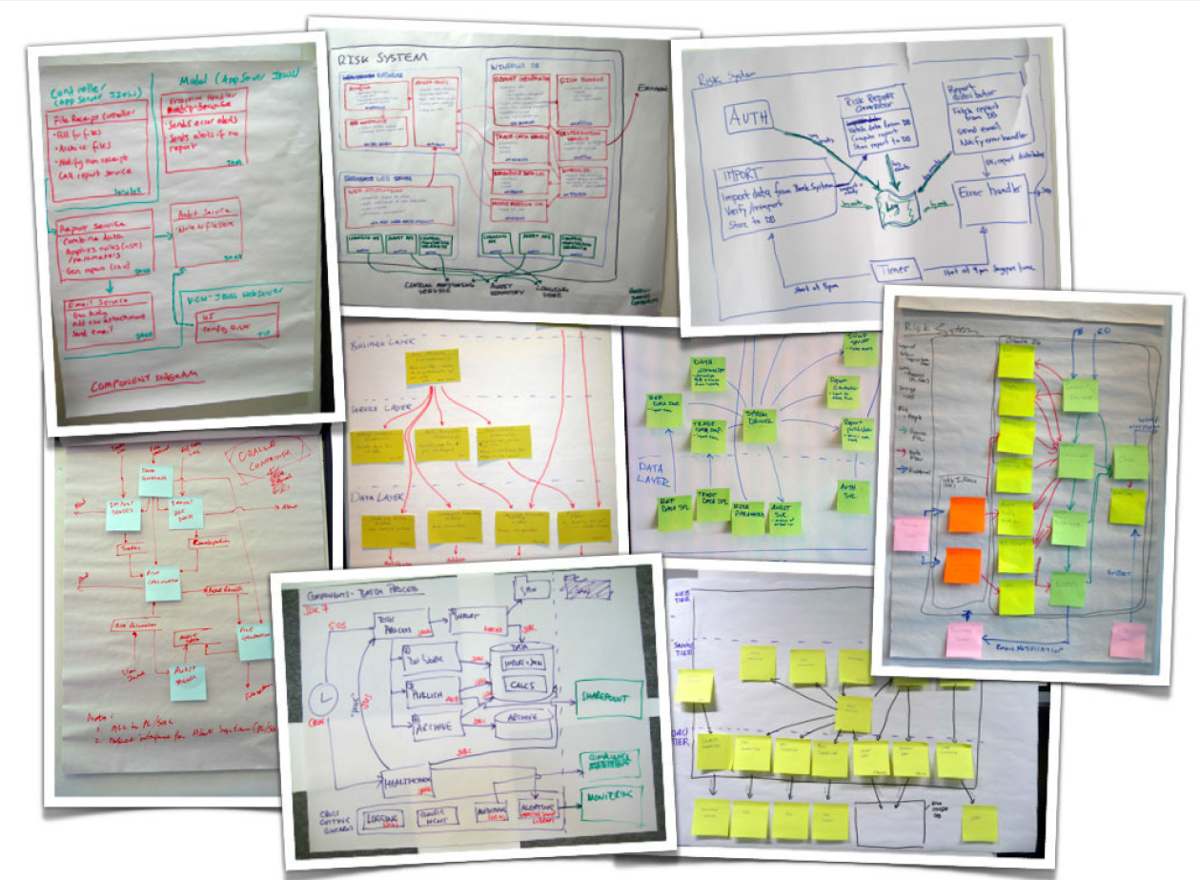
Documenting architecture
Traditional process
Software Architecture Document (SAD)
Agile process
4C model
Software
Architecture
Document

Slide 24
Agile architecture
Just enough upfront architecture
Refine the architecture later
Keep your architecture flexible
The architect is available during the whole project
The architect also writes code
But not all the time
The architecture is grounded in reality
Works together with the developers
Architects should be master builders
Proof the architecture in the first iteration(s)

Slide 25











Scrum
24 hour
sprint
Customers, users, marketing
sprint taskboard
Daily standup meeting
vision
Impediments list
1 – 4 weeks sprint
Product Owner
Sprint planning meeting
Scrum Master
1
2
3
1
4
2
5
6
3
7
4
8
Sprint backlog
Product backlog
Sprint review
burndown chart
Sprint retrospective

Slide 26




Scrum team
Scrum Master
Product Owner
Focus on the code
Developer
Developer
Who owns the big picture (structure, vision) ?
Developer
Developer
Developer
Developer
Developer

Slide 27
Why software architecture in agile?
We need a clear vision and roadmap for the team to follow.
We need to identifying and mitigating risk.
We have to communicate our solution at different levels of abstraction to different audiences.
We need technical leadership
We have to make sure our architecture is consistent, correct and fits within the context

Slide 28
You need an architect
Scrum Master
Product Owner
Developer
Developer
I own the big picture (structure, vision) ?
Developer
Developer
Architect
Developer
Developer

Slide 29
Architect group
Marketing
Manager
Manager
Lead architect
Scrum master group
Product owner group
Architect group
Scrum Master
Product owner
Architect

Slide 30
Agile architecture
Discover architectural requirements
Design just enough to safely start the sprints
Sprint
Functional
Just enough upfront design
Qualities
Constraints
Principles
Refine the architecture

Slide 31
Architectural requirements
Discover architectural requirements
Refine the architecture
Design just enough to safely start the sprints
Sprint
Functional
Just enough upfront design
Qualities
Constraints
Principles

Slide 32
Functional requirements
What should the system functionally do?
Use cases
User stories
As a customer
I can view my account history
so that I know all transactions on my account
Functional
Qualities
Constraints
Principles

Slide 33
Architectural constraints
Constraints from the business (or enterprise architecture
We do everything in .Net
We always use an Oracle database
Our maintenance engineers all know Java
All applications talk with the Oracle ESB
Budget
Deadlines
Functional
Qualities
Constraints
Principles

Slide 34
Software qualities
Functional
Qualities
Constraints
Principles

Slide 35
NFR characteristics
Which qualities are available?
We need to balance the qualities
A quality itself is not precise enough
Stakeholders have different interests

Slide 36
SEI quality model
Performance
Security
Availability
Functionality
Usability
Responsiveness of the system
Ability to resist unauthorized usage
Portion of time the system is available
Ability to do intended work
Qualities noticeable at runtime
Learnability, efficiency, satisfaction, error
handling, error avoidance
Modifiability
Portability
Reusability
Integrability
Testability
Cost of introducing change
Ability to operate in different computing environments
Ability to reuse components in different applications
Ability that components work correctly together
Qualities not noticeable at runtime
Ability to systematic testing to discover defects

Slide 37
FURPS model
Functionality - evaluate the feature set and capabilities of the program, the generality of the functions delivered and the security of the overall system
Usability - consider human factors, overall aesthetics, consistency, and documentation
Reliability - measure the frequency and severity of failure, the accuracy of outputs, the ability to recover from failure, and the predictability
Performance - measure the processing speed, response time, resource consumption, throughput and efficiency
Supportability - measure the maintainability, testability, configurability and ease of installation

Slide 38
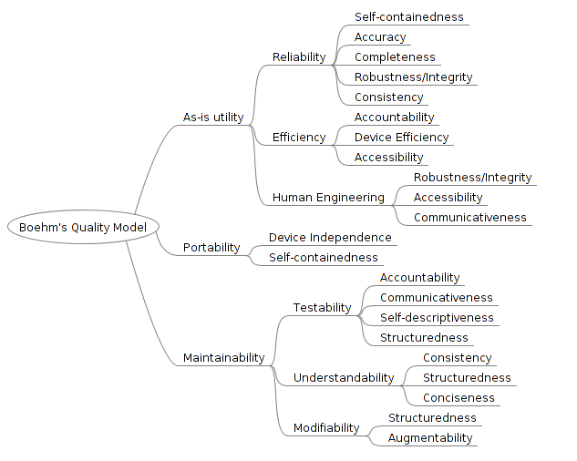
Boehm

Slide 39
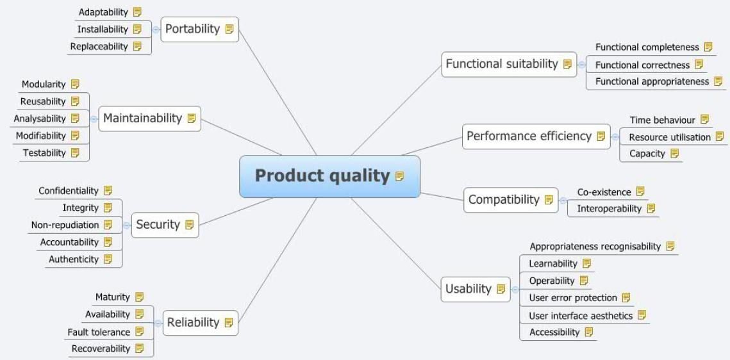
ISO 25010

Slide 40
NFR characteristics
Which qualities are available?
We need to balance the qualities
A quality itself is not precise enough
Stakeholders have different interests

Slide 41

Balance the qualities
More security through encription lowers performance
More scalability through clustering lowers performance
More scalability through clustering increases the cost
Find the top 5(+/- 2) qualitities

Slide 42
NFR characteristics
Which qualities are available?
We need to balance the qualities
A quality itself is not precise enough
Stakeholders have different interests

Slide 43

Quality scenario’s
A quality on itself has little meaning
Create scenario’s for the top qualitities
Make scenario’s measurable
The should be able to scale to 1000 concurrent users
The system should be available 24/7
All user actions should give a response within 3 seconds.
Prioritize the scenario's
Write acceptance tests for NFR scenario’s

Slide 44
NFR characteristics
Which qualities are available?
We need to balance the qualities
A quality itself is not precise enough
Stakeholders have different interests

Slide 45
Stakeholders
User
Customer
Developer
Application architect
Project manager
Tester
Maintenance
System administrator
Database administrator
Sales
Infrastructure architect
Hardware expert
Security architect
Trainer
Integration architect
Support engineer

Slide 46
Stakeholders and their interest
Performance
Reliability
Usability
Price
Features
On time delivery
Stability
Maintainability
Consistent and understandable architecture
Development guidelines
Stability of the infrastructure
Good tooling
User
Customer
Developer
Application architect
Project manager
Tester
Maintenance
System administrator
Database administrator
Sales manager
Infrastructure architect
Hardware expert
Security architect
Trainer
Integration architect
Support engineer
Enterprise architecture
Clear requirements
Clear requirements
Understandable architecture
Development guidelines
Tracability
Testability
Project resources
On time delivery
Quality of documentation
Consistent use of frameworks and patterns
Changability
Tracability
Testability
Ease of installation
Ease of monitoring
Price
Time-to-market
Features
Quality of DB schema
Hardware resources
Infrastructure needed
Security
Quality of user manual
Usability
Ease of installation
Ease of integration
Understandability
Ease of integration

Slide 47
Quality workshop
Goal:
Find the prioritized scenario’s of the top qualities.
Communicate the qualities between stakeholders
Workshop agenda
Explain the vision of the system
Explain the different qualitities
Everone votes (everyone gets $10 to divide)
Discuss the result
Vote again
Create scenario’s for the top qualitites
Prioritice the scenario’s (vote)

Slide 48
Qualitity workshop result

Slide 49
Most important qualities
Performance
Scalability
Availability
Reliability
Maintainability
Security
Interoperability
Usability

Slide 50
Performance
The responsiveness of the application to perform specific actions in a given time span.
Latency
The time taken by the application to respond to an event.
Throughput
The number of events scored in a given time interval.
Scenario’s
All actions must respond in 3 seconds
Complex actions must respond in 5 seconds

Slide 51
Scalability
The ability to handle an increase in the workload without impacting the performance
Scenario’s
The system should scale up to 100.000 users in a year
The system should be able to handle 5.000 concurrent users

Slide 52
Availability
The probability that the system is operating properly when it is requested for use
Calculated as uptime/total time
Scenario’s
The critical part of the system should be available 99.5% of the time (24 * 7)
The non critical part of the system should be available 98.3% of the time (24 * 7)

Slide 53
Reliability
The probability that the system is operating properly for a desired period of time without failure.
Mean Time Between Failure (MTBF)
Total time in service / number of failures
Scenario’s
Mean Time Between Failures = 100.000 hours
Mean Time To Recovery = 10 hours
Data is consistent all the time

Slide 54
Availability vs. Reliability
High reliability contributes to high availability
But you can achieve high availability with an unreliable system, if the recovery time is low.

Slide 55
Maintainability
The ability of any application to go through modifications and updates with a degree of ease.
Scenario’s
The system should be highly configurable
The system should have 80% test coverage
All errors should be logged

Slide 56
Security
3 aspects
Authentication: are you who you say you are?
Authorization: what are you allowed to do?
Secrecy: encrypt the data
Scenario’s
Only authorized users may access the system
All secret data that is sent to other systems should be encrypted

Slide 57
Interoperability
The ability to exchange information and communicate with internal and external applications and systems.
Scenario’s
All communication with external systems should use standards like SOAP, REST or messaging.
All interfaces should be defined and published.

Slide 58
Usability
The ease at which the users operate the system and make productive use of it.
Aspects:
Efficiency: How efficiently can a end user perform a task once they have learned the UI design
Learnability: Ease for end users to accomplish primitive processes the first time they encounter the UI.
Memorability: When users return to the system after a time frame, how quickly can they re-establish expertise
Errors: How many errors do end users make, how severe are these, and how easily can they recover from these errors?
Satisfaction: How pleasing is it to use the system
Scenario’s
The system should support the following browsers: Internet Explorer, Chrome, Mozilla Firefox, Safari, Netscape
The user can change the language to English, Chinese, French and Spanish.

Slide 59
Architecture principles
Functional
Qualities
Constraints
Principles

Slide 60
Architecture (design) principles
Keep it simple
Keep it flexible
Loose coupling
Separation of concern
Information hiding
Principle of modularity
High cohesion, low coupling
Open-closed principle

Slide 61

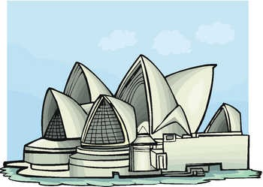
Keep it simple
The more complexity, the more change on failure
Simple applications, frameworks, tools, etc. remain to be used
Complex ones will be replaced by something simple
Gold plating

Slide 62

Keep it flexible
Everthing changes
Business
Technical
More flexibility leads to more complexity

Slide 63

Loose coupling
Different levels of coupling
Technology
Time
Location
Data structure
You need coupling somewhere
Important is the level of coupling

Slide 64


Separation of concern
Separate technology from business
Separate stable things from changing things
Separate things that need separate skills
Separate business process from application logic
Separate implementation from specification

Slide 65

Information hiding
Black box principle
Hide implementation behind an interface
Hide the data structure behind stored procedures
Hide the data structure behind business logic

Slide 66


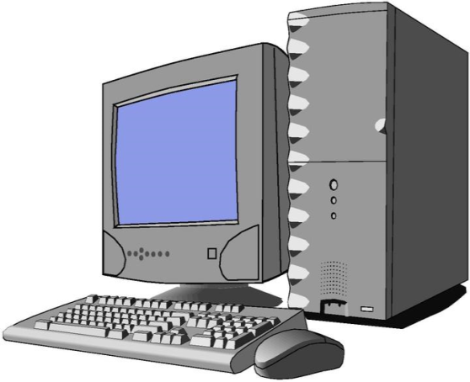
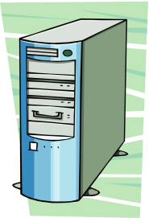
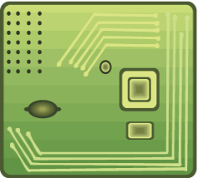
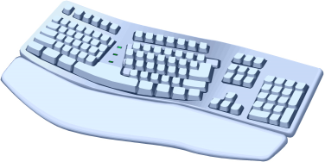

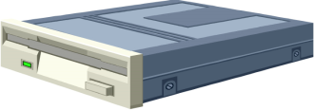
Principle van modularity
Decomposition
Devide a big complex problem is smaller parts
Use components that are
Better understandable
Independent
Reusable
Leads to more flexibility
Makes finding and solvings bugs easier

Slide 67
High cohesion, low coupling
High coupling, low cohesion
High cohesion, low coupling

Slide 68


Open- closed principle
The design should be “open” for extension, but “closed” for change.
You want to add new functionality instead of changing existing, working and tested code.

Slide 69



Abstraction
Focus on only the important aspects.
Interface
Abstract class
Library customer:
name
address
phone
age
Shopping customer:
name
shipping address
phone
credit card number
billing address
Hospital customer:
name
address
phone
insurance company
birth date

Slide 70
Main point
Software architecture is never ideal. We have to find the right balance between the different software qualities and architecture principles
Nature always takes the path of least resistance so that the perfection of the unified field can express itself in the relative creation

Slide 71
communicating architecture

Slide 72
Architecture visibility
Make the architecture visible with diagrams
Information radiator

Slide 73
Effectiveness of communication

Slide 74
Structure and Vision
Context diagram: Shows the big picture
Container diagram: shows the high-level shape of the software architecture and how responsibilities are distributed across it. It also shows the major technology choices and how the containers communicate with one another.
Component diagram: Decompose each container further into a number of distinct components, services, subsystems, layers, workflows, etc.
Detailed diagrams: Class diagram, sequence diagram, deployment diagram

Slide 75
Agile architecture
Discover architectural requirements
Sprint
Functional
Context
Qualities
Containers
Constraints
Components
Principles
Classes
Design and visualize the architecture

Slide 76
Context diagram
Context
Shows the big picture
10 km view
Containers
Components
Classes
interaction
External entity
The system
External entity
Users
Organisations
Other systems

Slide 77
Context diagram
Why?
It makes the context explicit so that there are no assumptions.
It shows what is being added (from a high-level) to an existing IT environment.
It’s a high-level diagram that technical and non-technical people can use as a starting point for discussions.
It provides a starting point for identifying who you potentially need to go and talk to as far as understanding inter-system interfaces is concerned.
Should only take a couple of minutes to draw, so there really is no excuse not to do it

Slide 78
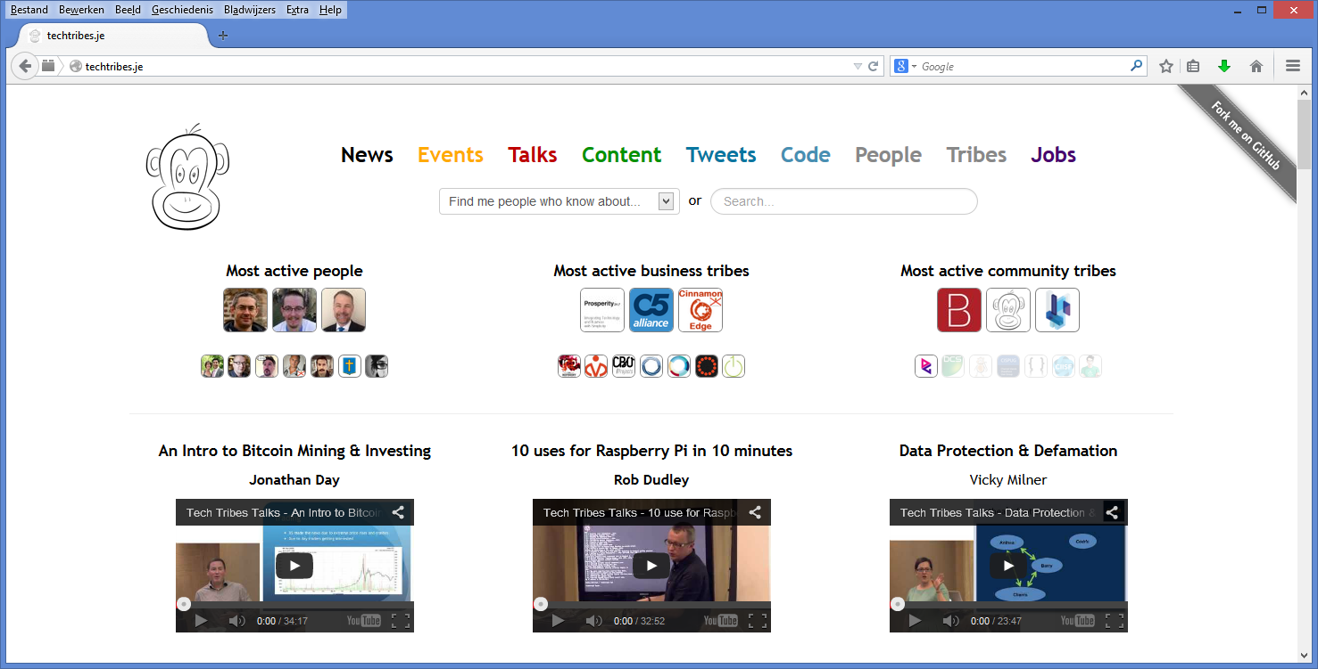
Example: Techtribes.je
Website that provides a way to find people, tribes (businesses, communities, interest
groups, etc) and content related to the tech, IT and digital sector in Jersey and Guernsey. At the most basic level, it’s a content aggregator for local tweets, news, blog posts, events, talks, jobs and more.

Slide 79
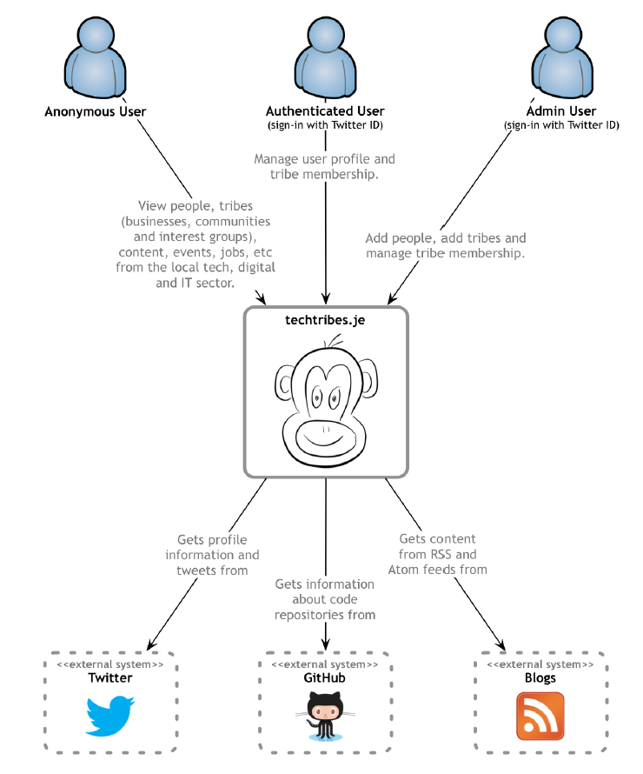
Techtribes.je context diagram

Slide 80
Container diagram
Shows the high-level shape of the software architecture and how responsibilities are distributed across it. It also shows the major technology choices and how the containers communicate with one another.
Containers are the logical executables or processes that make up your software system
Web servers
Application servers
ESBs
Databases
Other storage systems
File systems
Windows services
Standalone/console applications
Web browsers
For each container specify:
Name: “Web server”, “Database”, …)
Technology: (e.g. Apache Tomcat 7, Oracle 11g, …)
Responsibilities: A very high-level statement or list of the container’s responsibilities.
Everything on a container diagram should potentially deployable separately
Context
Containers
Components
Classes

Slide 81
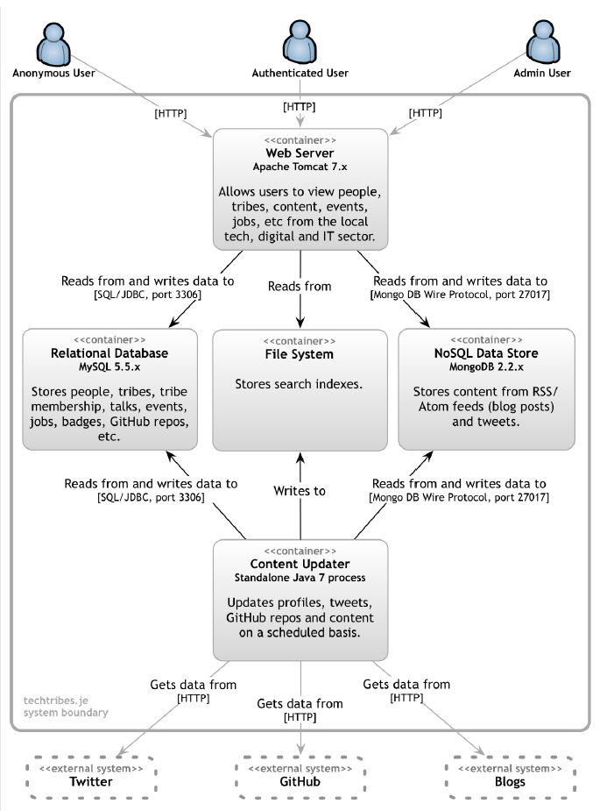
Techtribes.je container diagram
Describe the interactions :
Purpose (“reads/writes data from”, “sends reports to”).
Communication method (Web Services, REST, Java RMI, JMS).
Communication style (synchronous, asynchronous, batched, two-phase commit)
Protocols and port numbers ( HTTP, HTTPS, SOAP/HTTP, SMTP, FTP).
Show the boundary of what you are building

Slide 82
Container diagram
Why?
It makes the high-level technology choices explicit.
It shows where there are relationships between containers and how they communicate.
It provides a framework in which to place components (i.e. so that all components have a home).
It provides the often missing link between a very high-level context diagram and (what is usually) a very cluttered component diagram showing all of the logical components that make up the entire software system.

Slide 83
Component diagram
Decompose each container further into a number of distinct components, services, subsystems, layers, workflows, etc.
For each of the components drawn on the diagram, you could specify:
Name: The name of the component (“Risk calculator”, “Audit component”, etc).
Technology: The technology choice for the component (Plain Old Java Object, Enterprise JavaBean, etc).
Responsibilities: A very high-level statement of the component’s responsibilities (either important operation names or a brief sentence describing the responsibilities).
Context
Containers
Components
Classes

Slide 84
Component diagram

Slide 85
Behavior of the components

Slide 86
Component diagram
Why?
It shows the high-level decomposition of your software system into components with distinct responsibilities.
It shows where there are relationships and dependencies between components.
It provides a framework for high-level software development estimates and how the delivery can be broken down.

Slide 87
Detailed diagrams
class diagram
sequence diagram
state machine diagram
activity diagram
Context
Containers
Components
Classes

Slide 88
Agile diagrams
Know the purpose of the diagram before you start
Only draw diagrams that you really need
The diagram should fit on one page
And should still be readable
Do not clutter the diagram with too much information
Remember what the purpose is
What is allowed in the diagram?
Whatever fits the purpose
You don’t need an UML tool.

Slide 89
Identify risk

Slide 90
Identify risk
Discover architectural requirements
Identify risks
Sprint
Functional
Context
Qualities
Containers
Risk storming
Constraints
Components
Principles
Classes
Design and visualize the architecture

Slide 91
Quantify risk
Probability
How likely is it that the risk will happen?
Do you think that the chance is remote or would you be willing to bet cash on it?
Impact:
What is the negative impact if the risk does occur?
Is there general discomfort for the team or is it back to the drawing board?
Will it cause your software project to fail?

Slide 92
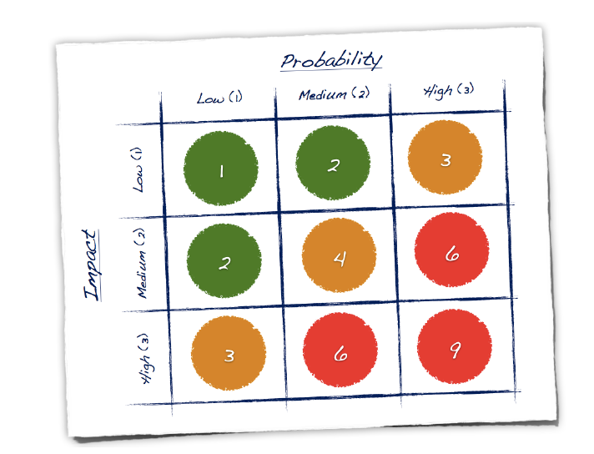
Probability/impact matrix

Slide 93
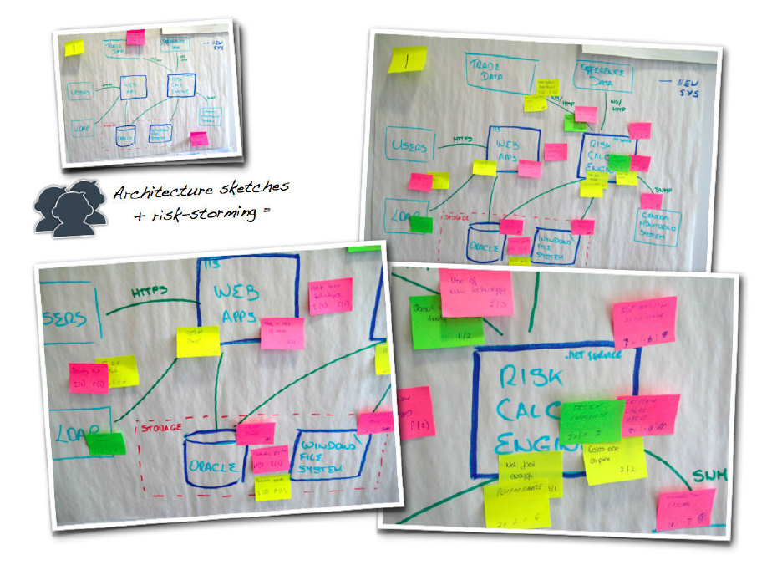
Risk storming
Quick and fun technique that provides a collaborative way to identify and visualize risks.

Slide 94
Risk storming
Step 1. Draw the architecture diagrams
on whiteboards or large sheets of flip chart
Step 2. Identify the risks individually
The whole team stand in front of the architecture diagrams and individually write down the risks that they can identify, one per sticky note.
Quantify the risk
Use different colors of sticky note to represent the different risk priorities.

Slide 95
Risk storming
Step 3. Converge the risks on the diagrams
Everybody places their sticky notes onto the architecture diagrams, sticking them in close proximity to the area where the risk has been identified.
Step 4. Prioritize the risks
Take each sticky note (or cluster of sticky notes) and agree on how you will collectively quantify the risk that has been identified.

Slide 96
Just enough architecture
Discover architectural requirements
Identify risks
Sprint
Functional
Context
Qualities
Containers
Risk storming
Constraints
Components
Principles
Classes
Design and visualize the architecture
Proof the architecture
Refine the architecture

Slide 97
Main point
Software architecture is best communicated in visual diagrams starting with the abstract context diagram all the way down to the detailed class diagrams
The orderly sequential unfoldment of creation is a reflection of pure consciousness. The Vedas are expressions of the structure of this pure consciousness

Slide 98
Connecting the parts of knowledge with the wholeness of knowledge
Software architecture defines all important aspects of a system.
The architecture decisions are based on the functional requirements, the qualities, the business constraints and the architecture principles
Transcendental consciousness is the natural experience pure consciousness, the home of all the laws of nature.
Wholeness moving within itself: In unity consciousness, one appreciates and enjoys the underlying blissful nature of life even in all the abstract expressions of pure consciousness.

Slide 99
summary

Slide 100
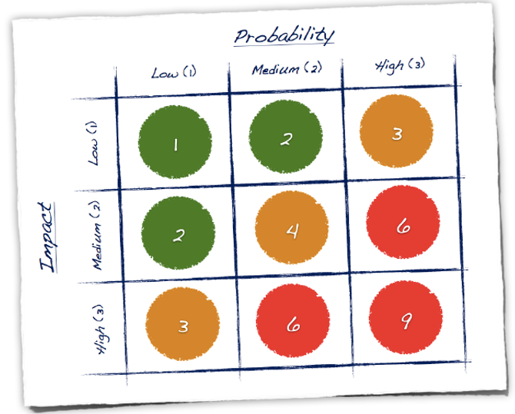
Agile architecture
Refine the architecture in the Sprints
Functional
Use cases
User stories
Scenarios
Processes
Business rules
Acceptance criteria
…
Context diagram: Shows the big picture.
Identify risks
Qualities
Container diagram: Shows the high-level software architecture using containers and technology choices.
Performance
Scalability
Reusability
Security
Availability
Modifiability
…
Risk storming
Component diagram: Decompose each container further into a number of distinct components.
Constraints
Budget
Deadlines
Enterprise arch.
Experience
…
Detailed diagrams: Class diagram, sequence diagram, deployment diagram.
Principles
Keep it Simple
Separation of concern
Loose coupling
Information hiding
Modularity
Flexibility
…
Proof the architecture.
Do the most risky things first.
Design and visualize the architecture
Architectural requirements

Slide 101
Architecture (design) principles
Keep it simple
Keep it flexible
Loose coupling
Separation of concern
Information hiding
Principle of modularity
High cohesion, low coupling
Open-closed principle

Slide 102
Most important qualities
Performance
Scalability
Availability
Reliability
Maintainability
Security
Interoperability
Usability

